Slide 1

STATE OF TEXAS v
PAUL ROSALES-CHAPLIN

Slide 2

DWI v. INTOX ASSAULT

Slide 3
ACCIDENTS
NOT DELIBERATES

Slide 4
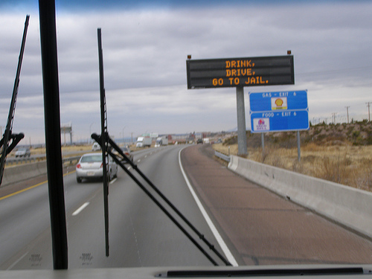
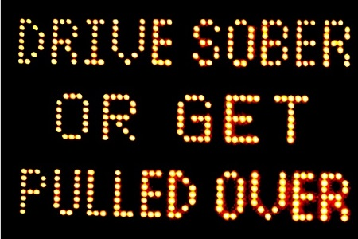
DRINKING
Drink, Drive, Go to Jail
Drive Sober or Get Pulled Over
Going Out Tonight, So Are We

Slide 5

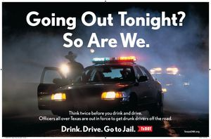

Slide 6
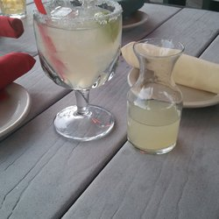

NOT ILLEGAL TO DRINK AND THEN DRIVE; as long as you’re NOT intoxicated

Slide 7
DRINKING PATTERNS
A. REGULARLY
B. OCCASIONALLY
C. RARELY
D. NEVER
E. NOT ANY MORE

Slide 8
ALCOHOL
MEMBER OF MADD
MEMBER OF AA
STRONGLY AGREE WITH “NO REFUSAL” WEEKENDS
ALCOHOLISM IN FAMILY
NO ALCOHOL IN HOME
INJURED/VICTIM OF ALCOHOL RELATED CRIME

Slide 9
TRUE OR FALSE?
I BELIEVE THE DRINKING AND DRIVING LAWS ARE NOT SEVERE ENOUGH IN OUR STATE?

Slide 10
TRUE OR FALSE?
IF SOMEONE IS GUILTY OF INTOXICATED ASSAULT, THEY SHOULD PROBABLY GO TO PRISON?

Slide 11
PUNISHMENT
INTOXICATED ASSAULT (3rd Degree)
  2-10 Years Prison
  and/or
  2-10 Years Probation
    AT LEAST 30 DAYS IN JAIL
  $10,000.00 fine

Slide 12


Slide 13
PUNISHMENT
INTOXICATED ASSAULT (3rd Degree)
  2-10 Years Prison
  and/or
  2-10 Years Probation
    AT LEAST 30 DAYS IN JAIL
  $10,000.00 fine

Slide 14
WHO CAN’T EVEN CONSIDER PROBATION?

Slide 15
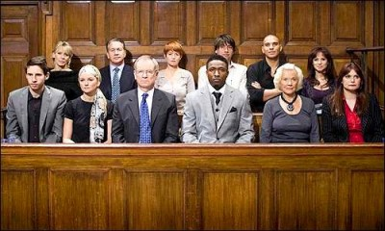


JURY SERVICE

Slide 16
THANK YOU

